Slide 1
Veyon
Remote Control Desktop Software

Slide 2
Table of contents
01
02
03
04
05
Introduction
Remote Control, Remote Access and Remote Administration
Remote Access Common Protocols
Generic feature
Use and advantages
Limitations

Slide 3
Remote Control
It is the ability to control a device or system from a different location through a remote connection, such as a television remote control that allows you to change channels or adjust the volume from across the room.
It also allows the operation and management of electronic devices, computer systems, industrial equipment, among others, without the need to be physically present in the place where the devices are located.

Slide 4
Remote Access
Remote access is essential to be able to access information that does not require you to be physically there as it could be in modern work environments, allowing employees to access files, applications, and company resources from locations outside the main office. It is also used in technical support to solve problems in computer systems and in server management.

Slide 5
Remote Administration
Remote administration is essential for the efficient management of IT infrastructures (a set of information technology components), as it allows administrators to monitor system performance, apply software updates, troubleshoot problems, and perform maintenance tasks. Without the need to be physically present in the place where the devices or servers are located. This is especially useful in geographically distributed business environments or in companies with dispersed IT teams.

Slide 6
Remote Access Common Protocols
Remote Desktop Protocol (RDP): Allows users to connect to and control a remote desktop of a Windows computer over the network.
Virtual Network Computing (VNC): Allows you to remotely view and control the screen and keyboard of a computer system.
Secure Shell (SSH): Primarily used in Unix and Linux environments, SSH provides a secure channel through a command line.
Telnet: Although less secure than SSH, Telnet allows remote access to systems and devices for management through a command line interface.
File Transfer Protocol (FTP) and Secure FTP (SFTP): Allow file transfer between remote and local systems.

Slide 7
Generic features of these kind of software
Veyon is a classroom management and monitoring software designed for educational environments.
Some features are:
Remote Monitoring
Screen Broadcasting
Application Control
Remote Control
File Distribution
Communication Tools
Classroom Management
Security and Privacy
Notes:
Remote Monitoring: Veyon allows teachers to view and monitor students' computer screens in real-time, providing a way to ensure that students stay on task during lessons.
Screen Broadcasting: Teachers can broadcast their own screen or a selected student's screen to the entire class, making it easy to share information, demonstrate tasks, or showcase exemplary work.
Application Control: Veyon enables teachers to control which applications or websites students can access during class, helping to maintain focus and prevent distractions.
Remote Control: Teachers have the ability to remotely control students' computers, providing assistance or guiding them through tasks as needed.
File Distribution: The software allows for the distribution of files from the teacher's computer to the students' computers, streamlining the sharing of educational materials.
Communication Tools: Veyon often includes communication features such as chat or messaging systems, facilitating interaction between teachers and students, or among students themselves.
Classroom Management: Veyon assists in managing the classroom environment by providing features like the ability to lock students' screens, shut down or restart their computers, and send messages to individuals or the entire class.
Security and Privacy: The software typically prioritizes security and privacy, ensuring that monitoring and control features are used responsibly and that sensitive information is protected.

Slide 8
Use and advantages
Allows administrators to view the desktops of multiple computers simultaneously and provides real-time monitoring of user activity.
Enables administrators to broadcast their screen or a specific application to selected or all connected devices.
Administrators can manage and control applications on remote computers.
Simplifies file distribution by allowing administrators to send files remotely.
Remotely manage the power state of connected computers, enabling efficient shutdowns, restarts, or logoffs across the network.
Centralized management console.
Time and resource savings.
Available on different operating systems.
Veyon is a robust remote management software solution that streamlines administrative tasks, enhances efficiency, and ensures a secure and controlled computing environment in educational and corporate settings.

Slide 9
Limitations
Limited bandwidth: The speed and reliability of the remote connection may be affected by limitations in network bandwidth.
Security: Remote access can present security risks, especially if proper authentication and encryption measures are not implemented.
Device Compatibility: Some systems or applications may not be fully compatible with available remote access tools.
Reliance on internet connectivity: Remote access generally requires a stable and reliable internet connection.
System performance: The performance of remote systems can be affected by workload, hardware capacity, and other factors.
Privacy and Compliance: In certain cases, privacy and compliance regulations may limit remote access to certain data or resources.

Slide 10
Table of contents
01
02
Terminal emulation (tty) vs Remote Control Desktop software
When to use each?
Commons situations of use

Slide 11
When to use each?
Terminal emulation (TTY):
Terminal emulation is useful when you need to access remote systems quickly and efficiently, especially in text and command-based environments. It is commonly used in UNIX and Linux environments.
Remote desktop software:
Remote desktop software is ideal when you need to access and control a remote system that has a graphical user interface (GUI), including programs and applications that cannot be run from a terminal.

Slide 12
Commons situations of use
Terminal emulation (TTY):
Remote administration of UNIX/Linux servers and systems.
Command line access to perform administration, configuration, and maintenance tasks.
Debugging operating system level issues and executing commands on remote servers.
Remote desktop software:
Remote Technical Support: Allows technicians to access an end user's desktop to troubleshoot and perform configurations.
Remote Work: Allows employees to access their desktops and corporate applications from external locations.
Demonstrations and Presentations: Facilitates software demonstration and real-time collaboration through remote desktop viewing.

Slide 13
Table of contents
01
02
03
04
05
Analyzing One particular remote control desktop software
Requirements HW / SW
Main features
Price and value for money
Compare it with an alike SW
Recorded demo

Slide 14
Requirements HW / SW
HW:
Processor: A processor of at least 1 GHz is recommended.
RAM: At least 512 MB of RAM is recommended.
Disk space: At least 100MB of free disk space is recommended for installation and data storage.
Graphics Card: No minimum graphics card requirements are specified, but a standard graphics card should be sufficient for Veyon features.
Network: A TCP/IP compatible network card.
SW:
Operating System: Veyon is compatible with a variety of operating systems, including Windows (since Windows 7), Linux, and macOS.
Software dependencies: You may need to install certain software dependencies, such as the Qt Framework, to run Veyon on your system.

Slide 15
Main features
Remote Computer Control: Allows system administrators and educators to remotely control user computers within a local network.
Real-time monitoring: Provides the ability to view users' computer screens within the network in real time.
Communication: Facilitates communication between system administrators and computer users.
File and Link Distribution: Allows administrators to distribute files and links to computer users within the network efficiently.
Security and Privacy: Provides security and privacy features that protect the integrity of remote control sessions and monitoring.
Centralized Administration: Provides a centralized administration interface that allows system administrators to configure and manage all Veyon features efficiently.

Slide 16
Price and value for money
As of my last update in January 2022, Veyon is open source software distributed under the GNU General Public License (GPL).
In terms of value for money, Veyon offers an excellent proposition as it provides a wide range of features to control and monitor computers in educational and business environments without incurring licensing costs.
However, it is important to note that although the software itself is free, there may be costs associated with implementation and maintenance, such as staff training, network configuration, and technical support.
Overall, Veyon's value for money is high, especially for organizations looking for a remote control and computer monitoring solution that is reliable, secure, and free.

Slide 17
Compare it with an alike SW
A software similar to Veyon is the famous remote control and monitoring software called “Remote Desktop Services” from Microsoft.
Price:
Veyon: Free and open source.
Remote Desktop Services: Requires client access licenses (CALs) for each user or device that connects to the RDS server.
Functionality:
Veyon: Offers basic remote control and monitoring functions.
Remote Desktop Services: Provides more advanced functionality.
Easy to use:
Veyon: Has a relatively low learning curve.
Remote Desktop Services: Requires more advanced configuration
Support and Community:
Veyon: Being open source, it has an active community of users
Remote Desktop Services: Has official support from Microsoft and access to detailed documentation, but support may require additional support contracts.

Slide 18
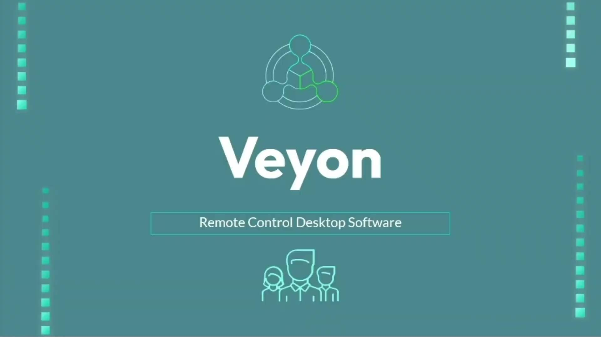
Recorded demo

